Slide 1
Domain 1 Information Security and Risk Management

Slide 2
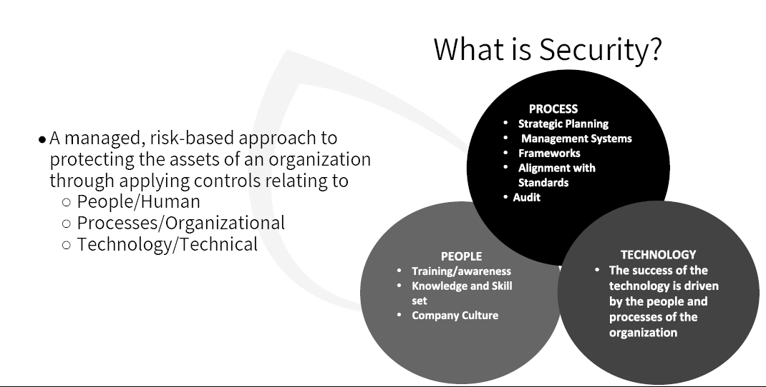

Slide 3
The 5 pillars of information security
THE 5 PILLARS OF INFORMATION SECURITY
They are confidentiality, integrity, and availability, authenticity, and nonrepudiation
Know what "The 5 pillars"
refers to before exam day

Slide 4
DOMAIN 1: SECURITY & RISK MANAGEMENT
Confidentiality
Access controls help ensure that only
authorized subjects can access objects

Slide 5
DOMAIN 1: SECURITY & RISK MANAGEMENT
Integrity
Ensures that data or system configurations
are not modified without authorization

Slide 6
DOMAIN 1: SECURITY & RISK MANAGEMENT
Availability
Authorized requests for objects must
be granted to subjects within a
reasonable amount of time

Slide 7
Security Governance
Security must be assessed and verified
Security is not just an IT issue
Affects every aspect of an organization

Slide 8
Security Governance Principles
Top-down vs Bottom-Up Security Management and Organization structure.
Bottom-Up: IT Security is seen as a nuisance and not a helper, often change when breaches happen.
Top-Down: IT leadership is on-board with IT Security; they lead and set the direction. (The Exam).

Slide 9
DOMAIN 1: SECURITY PLANNING
Security Planning
Should include three types of plans
Strategic. Long term, stable plan that should include a
risk assessment.
(5-yr horizon, annual updates)
Tactical. Midterm plan developed to provide more
details on goals of the strategic plan.
(usually ~1 year)
Operational. Short-term, highly detailed plan based
on the strategic and tactical plans.
(monthly, quarterly)

Slide 10
Security Frameworks
The intent of a framework is to document and organize the requirements a security program will be built on
Some information security frameworks include:
ISO 27000 Series
NIST Cybersecurity Framework

Slide 11
ISO 27000 Series
ISO 27001: Model for establishing, implementing, operating, and improving an information security management system (best practices)
ISO 27002: Provides practical advice on how to implement security controls.
It has 14 domains it uses for ISMS (Information Security Management Systems) (How to implement the best practices)
ISO 27004: Provides metrics for measuring the success of your ISMS.
ISO 27005: Risk management.
ISO 27799: Directives on how to protect PHI (Personal Health Information).

Slide 12
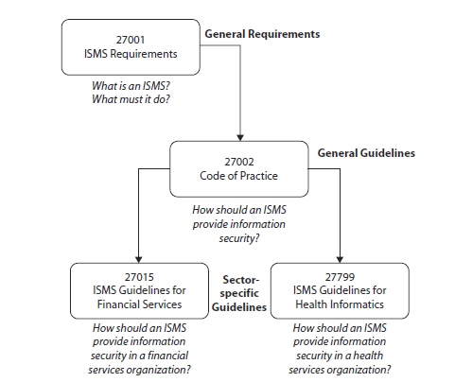
ISO 27000 Series

Slide 13
ISO/IEC 27001:2022
SECURITY CONTROL FRAMEWORKS
Cloud security is now covered in
the 2022 update to the standard
Outlines a framework for implementing, maintaining, and continually improving an Information Security Management System (ISMS)
An ISMS is a set of policies, processes, and controls that helps organizations protect their information assets.
Guides organizations in:
Identifying information assets and assessing their value and information security risks AND
Implementing mitigating security controls (based on ISO 27002)
Regularly monitoring and measuring effectiveness of and continuously improving the ISMS

Slide 14
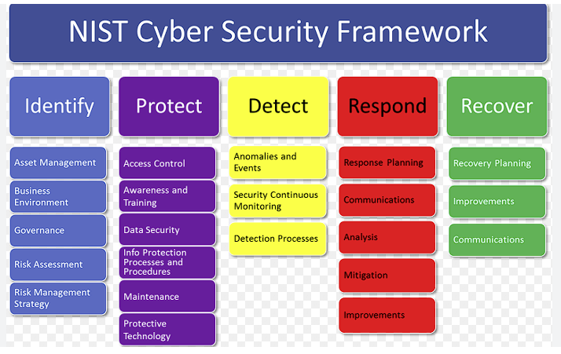
Cybersecurity Framework | NIST

Slide 15
FRAMEWORKS
A note about the NIST Risk Management Framework (RMF) and NIST Cybersecurity Framework (CSF)
RMF's audience is federal government agencies
The RMF is MANDATORY for those to which it applies
CSF is aimed at private (commercial) business
The CSF is purely OPTIONAL guidance from NIST
…though both address cybersecurity risk management.

Slide 16
FRAMEWORKS
Stated simply:
Risk frameworks
address the "why" - they guide strategic decision-making about risk.
Security control frameworks
address the "how" – providing specific controls to mitigate cybersecurity risks.
SABSA
adds another "how" layer by focusing on the structure and design of the security architecture itself.

Slide 17
COBIT
security control framework
IT management and governance framework
Principle 1: Meeting Stakeholder Needs
Principle 2: Covering the Enterprise End-to-End
Principle 3: Applying a Single, Integrated Framework
Principle 4: Enabling a Holistic Approach
Principle 5: Separating Governance from Management
little coverage and no depth on CISSP !

Slide 18
FRAMEWORKS
The Sherwood Applied Business Security Architecture (SABSA)
SABA appears in both Risk and Security Control Frameworks
Security
Control
Frameworks
Provide a prescriptive set of cybersecurity safeguards and best practices to protect an organization's valuable assets
Help in implementing the risk management strategy
Risk
Frameworks
Provide a structured approach to identifying, assessing, prioritizing, and managing risk to guide decision-making
Provide the overarching structure for making risk-informed decisions.

Slide 19
FedRAMP
SECURITY CONTROL FRAMEWORKS
Federal Risk and Authorization Management Program
a government-wide program that provides a standardized approach to security assessment, authorization, and continuous monitoring for cloud products and services.
GOALS
Accelerate secure cloud adoption
Enhance trust in cloud solutions
Promote a reusable approach for multiple agencies

Slide 20
Policies, Standards, Baselines, Guidelines, and Procedures

Slide 21
Security Program should be based on
Policies
Standards
Procedures
Guidelines
Baselines

Slide 22
Policies
Can be one of four general types
Regulatory – ensures an organization is following required regulations (finance, health)
Advisory – strongly advises employees as to which types of behaviors should/should not take place
Informative – informs employees of goals and missions relevant to a company, not specific or enforceable
Directive – Sets the direction of the organization (see next slide)

Slide 23
Components of Program Policy
All policy should contain these basic components:
Purpose describes the need for the policy, typically to protect the confidentiality, integrity, and availability of protected data.
Scope describes what systems, people, facilities, and organizations are covered by the policy.
Any related entities that are not in scope should be documented, to avoid confusion.
Responsibilities include responsibilities of information security staff, policy and management teams, as well as responsibilities of all members of the organization.
Compliance describes two related issues: how to judge the effectiveness of the policies (how well they are working) and what happens when policy is violated (the sanction).
All policy must have “teeth'’: a policy that forbids accessing explicit content via the Internet is not useful if there are no consequences for doing so.

Slide 24

Exam Note
A policy needs to be technology and solution independent.
It must outline the goals and missions, but not tie the organization to specific ways of accomplishing them.
Nothing happens without a policy

Slide 25

Standards
Standards ensure that specific technologies and applications, are implemented in a uniform (standardized) manner across the organization.
Standards can give a policy its support and reinforcement
Organizational security standards may specify how hardware and software products are to be used.
They can also be used to indicate expected user behavior.

Slide 26
Exam Note
The term standard has more than one meaning in IT.
Internal documentation that lays out rules that must be followed is a standard.
But sometimes, best practices, as in the ISO/IEC 27000 series, are referred to as standards because they were developed by a standards body.
You need to understand the context of how the term is used.
The CISSP exam will not try and trick you on this word; just know that the industry uses the term in several different ways.

Slide 27
Baselines
The term baseline refers to a point in time that is used as a comparison for future changes.
Once risks have been mitigated and security put in place, a baseline is formally reviewed and agreed upon, after which all further comparisons and development are measured against it.
A baseline results in a consistent reference point.
Also, refers to a minimum level of security

Slide 28
Baselines
Somewhat Discretionary
Minimum acceptable security requirements for a system or process

Slide 29
Procedures
Procedures are detailed step-by-step tasks that should be performed to achieve a certain goal.
Procedures are considered the lowest level in the documentation chain because they are closest to the computers and users (compared to policies) and provide detailed steps for configuration and installation issues.
Procedures spell out how the policy, standards will be implemented in an operating environment.

Slide 30
Guidelines
Guidelines are recommended actions and operational guides to users, IT staff, operations staff, and others when a specific standard does not apply.
They can also be used as a recommended way to achieve specific standards when specific procedures do not apply.

Slide 31
Risk Management

Slide 32
Risk Management Purpose
The principal goal of an organization’s risk management process should be to protect the organization and its ability to perform its mission. Including, but not limited to its IT assets.
Risk is a function of the likelihood of a given threat exercising a particular vulnerability and the resulting impact of that adverse event on the organization.

Slide 33

Risk Management
Risk Management provides a cost/benefit comparison, which compares the annualized cost of controls (protections) to the potential cost of loss.
The core idea is that if something is worth $100,000, it does not make sense to spend $150,000 trying to protect it.

Slide 34
DOMAIN 1: RISK CATEGORIES
Risk Categories
Category is a group of potential causes of risk.
Damage. Results in physical loss of an asset or
the inability to access the asset.
Disclosure. Disclosing critical information
regardless of where or how it was disclosed.
Losses. These might be permanent or temporary,
including altered data or inaccessible data

Slide 35
DOMAIN 1: RISK FACTORS
Risk Factors
Something that increases risk or susceptibility
Physical damage. Natural disaster, power loss or
vandalism.
Malfunctions. Failure of systems, networks, or
peripherals.
Attacks. Purposeful acts whether from the inside or
outside, such as unauthorized disclosure.

Slide 36
DOMAIN 1: RISK FACTORS
Risk Factors (cont.)
Something that increases risk or susceptibility
Human errors. Usually considered accidental
incidents, whereas attacks are purposeful incidents.
Application errors. Failures of the application,
including the operating system.

Slide 37
DOMAIN 1: TYPES OF RISK
Residual
Inherent
Total
RISK

Slide 38
DOMAIN 1: TYPES OF RISK
Residual Risk
The risk that remains even with all
conceivable safeguards in place.

Slide 39
DOMAIN 1: TYPES OF RISK
Residual Risk
The risk management has chosen
to accept rather than mitigate.

Slide 40
DOMAIN 1: TYPES OF RISK
Inherent Risk
Newly identified risk not yet addressed
with risk management strategies

Slide 41
DOMAIN 1: TYPES OF RISK
Total Risk
The amount of risk an organization would face if no safeguards were implemented.

Slide 42
DOMAIN 1: TYPES OF RISK
Residual
Inherent
Total
AFTER
BEFORE
WITHOUT

Slide 43
DOMAIN 1: CONTROLS
Controls Gap
The amount of risk reduced by
implementing safeguards

Slide 44
DOMAIN 1: CONTROLS
Controls Gap
total risk – controls gap = residual risk

Slide 45
FOR THE
Be able to explain total risk, residual risk, and controls gap
EXAM

Slide 46
FOR THE
FORMULAS
EXAM
To calculate TOTAL RISK, know this formula:
threats * vulnerabilities * asset value = total risk

Slide 47
FOR THE
FORMULAS
EXAM
RISK can be defined as follows:
risk = threat * vulnerability

Slide 48
DOMAIN 1: RISK ANALYSIS
RISK ANALYSIS
Two ways to evaluate risk to assets: qualitative and quantitative

Slide 49
Risk Analysis Definitions
Asset – something that is of value to the organization
Threat - any potential danger or harmful event that can exploit a vulnerability and cause harm to a system, organization, or individual.
Threats can be intentional or unintentional in nature.
Vulnerability – a weakness or flaw in an operating system, network, or application.
A threat actor tries to exploit vulnerabilities to gain unauthorized access to data or systems.
Security vulnerabilities can arise for many reasons, including misconfigurations, design flaws, or outdated software versions.

Slide 50
THREAT AGENTS
are what cause the threats by exploiting vulnerabilities.
DOMAIN 1: RISK ANALYSIS

Slide 51
DOMAIN 1: RISK ANALYSIS
QUALITATIVE
Uses a scoring system to rank threats
and effectiveness of countermeasures
SUBJECTIVE

Slide 52
Qualitative Risk Analysis
How likely is it to happen and how bad is it if it happens?
More subjective and relatively quick to do.
Most often done to know where to focus the more extensive Quantitative Risk Analysis.

Slide 53
Qualitative Risk Analysis
• Pick an asset: A laptop. • How likely is one to get stolen or left somewhere? • How bad is it if it happens?
That really depends on a couple of things: • Is it encrypted? • Does it contain classified or PII/PHI content?

Slide 54
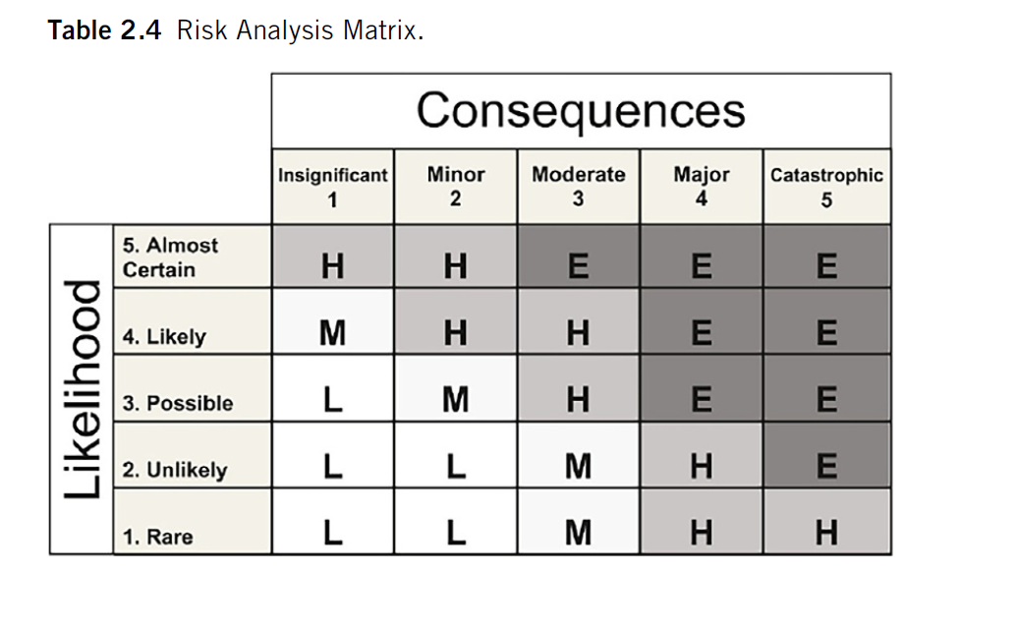
Risk Analysis Matrix

Slide 55
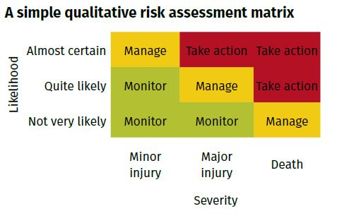
Qualitative Risk

Slide 56
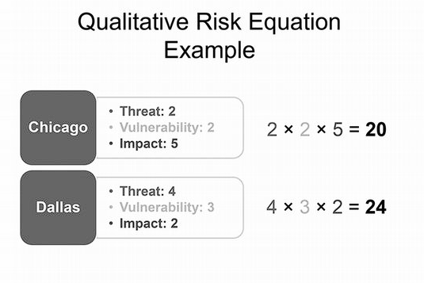
Qualitative Risk

Slide 57
DOMAIN 1: RISK ANALYSIS
DELPHI TECHNIQUE
An anonymous feedback-and-response
process used to arrive at a consensus.

Slide 58
QUANTITATIVE
Assigns a dollar value to evaluate
effectiveness of countermeasures
OBJECTIVE
DOMAIN 1: RISK ANALYSIS

Slide 59
Quantitative Risk Analysis
What will it actually cost us in $ ?
Numbers-based analysis, math is involved.

Slide 60
DOMAIN 1: CALCULATING RISK
Terms and formulas: (slides on each)
Important elements in quantifying potential loss
exposure factor (EF)
single loss expectancy (SLE)
annualized rate of occurrence (ARO)
annualized loss expectancy (ALE)
Safeguard evaluation

Slide 61
DOMAIN 1: CALCULATING RISK
Exposure Factor (EF)
Percentage of loss that an organization
would experience if a specific asset
were violated by a realized risk

Slide 62
DOMAIN 1: CALCULATING RISK
Single Loss
Expectancy (SLE)
Represents the cost associated with a single realized risk against a specific asset

Slide 63
DOMAIN 1: CALCULATING RISK
Single Loss
Expectancy (SLE)
SLE = Asset Value (AV) X Exposure Factor (EF)

Slide 64
DOMAIN 1: CALCULATING RISK
Single Loss
Expectancy (SLE)
AV EF SLE $100,000 X .3 (30%) = $30,000

Slide 65
DOMAIN 1: CALCULATING RISK
Annualized Rate
of Occurrence (ARO)
The expected frequency with which a specific
threat or risk will occur
within a single year.

Slide 66

Annual Rate of Occurrence (ARO)
Once in 10 years has an ARO of 0.1
Every 2 years would be an ARO of 0.5
Every 4 years would be 0.25
Every 5 years would be 0.2

Slide 67
DOMAIN 1: CALCULATING RISK
Annualized Loss
Expectancy (ALE)
The possible yearly cost of all instances of a
specific realized threat against a specific asset.

Slide 68
DOMAIN 1: CALCULATING RISK
Annualized Loss
Expectancy (ALE)
ALE = single loss expectancy (SLE) *
annualized rate of occurrence (ARO)

Slide 69
DOMAIN 1: CALCULATING RISK
ALE Example
Office Building = $200,000
Hurricane damage estimate 50%
Hurricane probability is one every 10 years 10%
(AV x EF = SLE) $200,000 x .50 = $100,000
(SLE x ARO = ALE) $100,000 x .10 = $10,000
value of the safeguard (annually)

Slide 70
Quantitative Risk Calculation
Tornado is estimated to damage 50% (.50) of a facility if it hits
The value of the facility is $200,000.
The probability is one tornado in ten (.10) years:
AV X EF = SLE = $200,000 x .50 = $100,000
SLE x ARO = ALE = $100,000 x .10 = $10,000
Averaged over ten years the ALE is $10,000
Management should not spend over $10,000 per year in countermeasures trying to protect against this risk

Slide 71
DOMAIN 1: RISK ANALYSIS STEPS
Risk Analysis Steps
The six major steps in quantitative risk analysis
1. Inventory assets and assign a value (asset value, or AV).
2. Identify threats. Research each asset and produce a list of all possible threats of each asset. (and calculate EF and SLE)
3. Perform a threat analysis to calculate the likelihood of each threat being realized within a single year. (the ARO)
4. Estimate the potential loss by calculating the annualized loss expectancy (ALE).
5. Research countermeasures for each threat and then calculate the changes to ARO and ALE based on an applied countermeasure.
6. Perform a cost/benefit analysis of each countermeasure for each threat for each asset.

Slide 72
DOMAIN 1: CALCULATING RISK
Safeguard
Evaluation
Good security controls mitigate risk,
are transparent to users, difficult to
Bypass and are cost effective

Slide 73
DOMAIN 1: CALCULATING RISK
cost
effective?
Safeguard
Evaluation
ALE before safeguard – ALE after safeguard
– annual cost of safeguard =
value of safeguard

Slide 74
DOMAIN 1: CALCULATING RISK
Safeguard
Evaluation
value of safeguard = ALE1 – ALE2 - ACS

Slide 75
DOMAIN 1: RESPONSE TO RISK
Response to Risk
Risk Acceptance. Do nothing, and you must
accept the risk and potential loss if threat occurs.
Risk Mitigation. You do this by implementing a
countermeasure and accepting the residual risk.
Risk Assignment. Transfer (assign) risk to 3rd party,
like by purchasing insurance against damage.
Risk Avoidance. When costs of mitigating or
accepting are higher than benefits of the service

Slide 76
DOMAIN 1: RESPONSE TO RISK
Response to Risk (cont)
Risk Deterrence. Implementing deterrents to
would-be violators of security and policy
Risk Rejection. An unacceptable possible
response to risk is to
reject risk or ignore risk.
REMEMBER:
Handling risk is not a one-time process!

Slide 77
FOR THE
You should remember that
not every risk can be mitigated
EXAM

Slide 78
FOR THE
It is management’s job to
decide how that risk is handled
EXAM

Slide 79
FOR THE
When multiple priorities present,
human safety is most important
EXAM

Slide 80
FOR THE
When legal issues are involved,
“call an attorney” is a valid choice
EXAM

Slide 81
DOMAIN 1: RISK MANAGEMENT FRAMEWORK
The primary risk management
framework referenced in CISSP is
NIST 800-37

Slide 82
DOMAIN 1: RISK MANAGEMENT FRAMEWORK
“7 steps of NIST 800-37”
1. Prepare to execute the RMF
2. Categorize information systems
3. Select security controls
4. Implement security controls
5. Assess the security controls
6. Authorize the system
7. Monitor security controls

Slide 83
DOMAIN 1: RISK MANAGEMENT FRAMEWORK
Consider the following RMFs “for use in the real world”:
OCTAVE
operationally critical threat, asset, and vulnerability evaluation
FAIR
Factor Analysis of Information Risk
TARA
Threat Agent Risk Assessment

Slide 84
DOMAIN 1: SUPPLY CHAIN
Supply Chain
Today, most services are delivered
through a chain of multiple entities

Slide 85
DOMAIN 1: SUPPLY CHAIN
Supply Chain
A secure supply chain includes vendors who
are secure, reliable, trustworthy, reputable

Slide 86
DOMAIN 1: SUPPLY CHAIN
Supply Chain Evaluation
When evaluating 3rd parties in the chain, consider:
On-Site Assessment Visit organization, interview
personnel, and observe their operating habits.
Document Exchange and Review Investigate dataset
and doc exchange, review processes
Process/Policy Review Request copies of their security
policies, processes, or procedures.
Third-party Audit Having an independent auditor provide an
unbiased review of an entity’s security infrastructure

Slide 87
DOMAIN 1: THREAT MODELING
Threat Modeling
Can be proactive or reactive, but in either
case, goal is to eliminate or reduce threats

Slide 88
DOMAIN 1: THREAT MODELING
3 approaches to threat modeling
Common approaches to threat modeling:
Focused on Assets Uses asset valuation results
to identify threats to the valuable assets.
Focused on Attackers Identify potential attackers
and identify threats based on the attacker’s goals
Focused on Software Considers potential threats
against the software the org develops.

Slide 89
DOMAIN 1: THREAT MODELING
Spoofing
Tampering
Repudiation
Information disclosure
Denial of service
Elevation of privilege
STRIDE
developed by
Microsoft

Slide 90
DOMAIN 1: THREAT MODELING
Damage potential
Reproducibility
Exploitability
Affected users
Discoverability
DREAD
based on answer
to 5 questions

Slide 91
DOMAIN 1: THREAT MODELING
Stage I: Definition of Objectives
Stage II: Definition of Technical Scope
Stage III: App Decomposition & Analysis
Stage IV: Threat Analysis
Stage V: Weakness & Vulnerability Analysis
Stage VI: Attack Modeling & Simulation
Stage VII: Risk Analysis & Management
PASTA
focuses on developing countermeasures based on asset value

Slide 92
DOMAIN 1: THREAT MODELING
Visual (represent systems graphically)
Agile (update as applications change)
Simple (make understandable by all people)
Threat (Any harmful actions)
VAST
based on Agile
PM principles
GOAL: Scalable integration of threat management
into an Agile programming environment

Slide 93
DOMAIN 1: THREAT MODELING
An open-source threat modeling process
that implements a
requirements model.
Ensures the assigned level of risk for each asset is “acceptable” to stakeholders.
TRIKE
focused on
“acceptable risk”

Slide 94
DOMAIN 1: THREAT MODELING
Diagramming
Potential Attacks
Determining potential attack concepts is
often achieved through diagramming

Slide 95

DOMAIN 1: THREAT MODELING
user / web
server boundary
SQL injection
users
web
service
Auth and data
retrieval
Login
SQL
Brute force, dictionary
DIAGRAMMING POTENTIAL ATTACKS

Slide 96
DOMAIN 1: THREAT MODELING
Reduction Analysis
Trust Boundaries. Any location where the level of trust
or security changes
Data Flow Paths. The movement of data between locations
Input Points. Locations where external input is received
Privileged Operations. Any activity that requires greater privileges than of a standard user account
Details about Security Stance and Approach.
declaration of security policy, security foundations, and
security assumptions.

Slide 97
DOMAIN 1: THREAT MODELING
Prioritization
and Response
Then threats are ranked or rated using
DREAD, high/medium/low rating, etc.

Slide 98
DOMAIN 1: CONTROLS
Security Controls
Security measures for countering and
minimizing loss or unavailability of
services or apps due to vulnerabilities

Slide 99
DOMAIN 1: CONTROLS
Security Controls
The terms safeguards and countermeasure may seem to
be used interchangeably

Slide 100
DOMAIN 1: CONTROLS
Security Controls
safeguards are proactive countermeasure are reactive

Slide 101

Control Types
In order to be sure of the control type, you need to clearly understand the context.

Slide 102
DOMAIN 1: SECURITY CONTROLS
Control Categories
There are three categories of security controls:
Technical. aka “logical”, involves the hardware or
software mechanisms used to manage access.
Administrative. Policies and procedures defined
by org’s security policy, other regulations and requirements
Physical. Are items you can physically touch.

Slide 103
DOMAIN 1: SECURITY CONTROLS
Control Types
Deterrent Deployed to discourage violation of security policies.
Preventative Deployed to thwart or stop unwanted or unauthorized activity from occurring.
Detective Deployed to discover or detect unwanted or unauthorized activity.
Compensating Provides options to other existing controls to aid in enforcement of security policies.

Slide 104
DOMAIN 1: SECURITY CONTROLS
Control Types
Deterrent. Deployed to discourage violation of
security policies.
Preventative. Deployed to thwart or stop unwanted or unauthorized activity from occurring.
Detective. Deployed to discover or detect unwanted or unauthorized activity.
Compensating. Provides options to other existing controls to aid in enforcement of security policies.

Slide 105
DOMAIN 1: SECURITY CONTROLS
Control Types (cont)
Corrective fix the problem or reduce its effects after an incident occurs.
Recovery restore the organization, system, or data back to normal operation after the incident. Often involves restoring from backups
Directive direct, confine, or control the actions of subjects to force or encourage compliance with security policies

Slide 106
Examples
Preventive
• Physical: Lock
• Technical: Firewall
• Administrative: Pre-employment drug screening (proper hiring practices)

Slide 107
Examples
Detective
• Physical: CCTV, light (used to see an intruder)
Technical: Intrusion Detection System (IDS)
Administrative: Post-hiring random drug tests

Slide 108
Examples
Deterrent
Physical: “Beware of dog” sign, light (deterring a physical attack)
• Technical: Warning Banner presented before a login prompt
• Administrative: Sanction policy

Slide 109
FOR THE
When developing new safeguards,
you are establishing a new baseline
EXAM

Slide 110
FOR THE
EXAM
…so, compliance with existing baselines
is not a valid consideration point.

